Slide 1

4. OSGi
Mundtlig Eksamen
Patrick Hansen
pahan19@student.sdu.dk

Slide 2
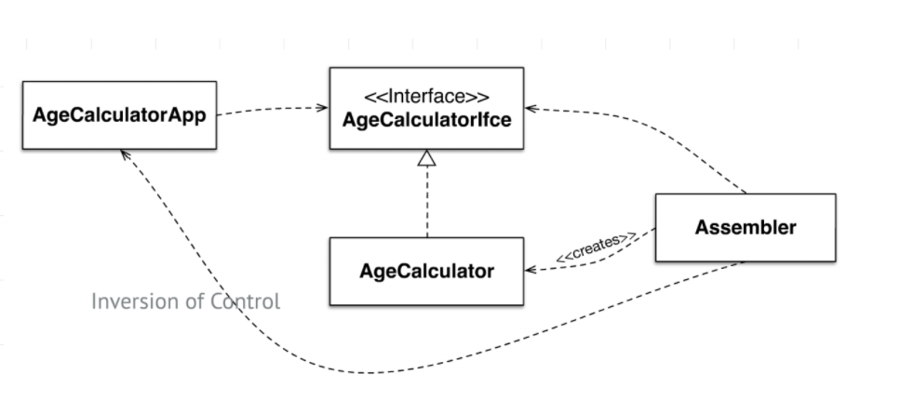
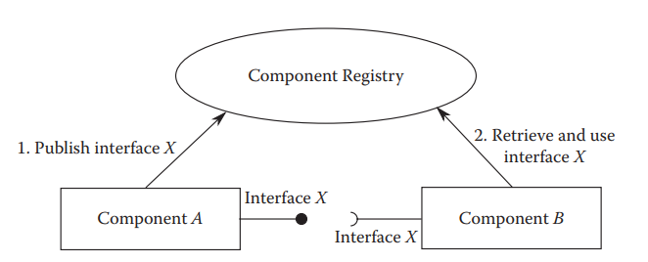
Komponent modeller
Dependency Inversion
Dependency Injection baserede modeller
Whiteboard
Registrering
Forespørgsel
Et par komponent frameworks
OSGi
Spring
NetBeans
Inversion of Control
Notes:
En component model er en standard der standardiserer mekanismerne til require/provide og kan automatisere assembly
## What are the different types of component models?
A component model is a definition of properties that components must satisfy, methods and mechanisms for the composition of components
### Dependency injection-based component models
Inversion of Control
Separate what-to-do part from when-to-do part.
Ensure that when part knows as little as possible about what part; and vice versa.
Dependency Inversion
Moduler afhænger af abstraktioner (interfaces)
Each component declares the set of interfaces provided by it and the set of interfaces required by it.
- The component framework analyzes this information on all the deployed components and injects the providing component references to requiring components
### Publish and consume whiteboard query-based component models
Each component registers the set of provided interfaces with a whiteboard registry.
- Any component requiring an interface queries the whiteboard registry to obtain a reference to the providing component.

Slide 3
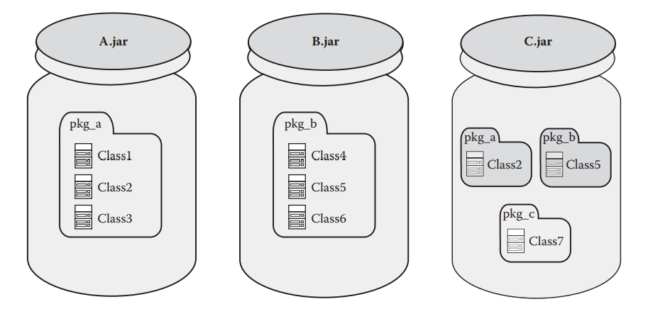
Flat Classpath problemet
Problemet med JAR fil-baseret komponent model
Flad classpath (præcedens!)
Komponent grænser ”opløses” ved runtime
Adfærd ændrer sig, runtime miljø bestemmer
OSGi er løsningen!

Slide 4
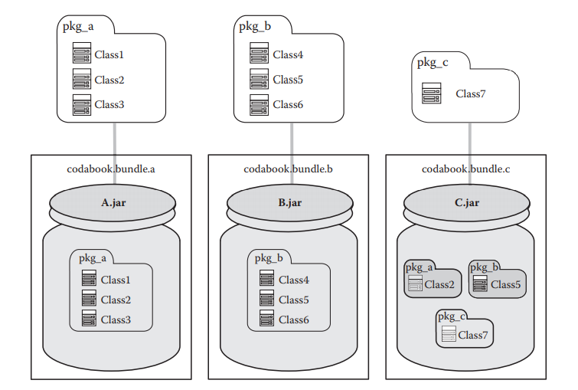
OSGi Module Layer (Bundles)
OSGi’s ”enhed”
Normal JAR fil…?
Eksplicit eksponering af pakker
Stærkere grænser
Notes:
Eksplicit eksponering af pakker: Loades indenfor class loading context of a bundle (sæt ned i noter)
## 2. How does OSGi overcome the problems of flat CLASSPATH?
It wraps a _module layer_ around the JAR file. A module/bundle is the unit of deployment in OSGI.
It is:
- a regular JAR file that contains
- class files
- resource files
- metadata
- special because
- it carries additional metadata relevant to OSGi in the manifest of the JAR file
- `META-INF/MANIFEST.MF`
The OSGi framework provides **stronger boundaries** around the bundle by:
- having bundles explicitly export packages
- Classes that could usually lead to dissolving boundaries are loaded within the class loading context of a bundle, and are not visible outside the bundle (assuming they arent exported).
As a result, our boundary is consistent irrespective of CLASSPATH definitions in the environment.
> Finer control around physical and logical boundaries of a component using OSGi bundles,
> because a bundle needs to explicitly define what portion of its internal code is externally visible
A bundle must also explicitly declare any external dependencies that is has with the code exposed by other bundles.
The OSGi framework matches the exports and imports of deployed bundles to dynamically wire (compose) the entire application. This is called bundle resolution and ensures consistency among the different bundles in terms of versions and other constraints.
### Module layer bundle resolution
The OSGi framework matches the exports and imports of deployed bundles to dynamically wire (compose) the entire application. This is called bundle resolution and ensures consistency among the different bundles in terms of versions and other constraints.
### Service Layer
The service layer provides a publish, find, and bind model of collaboration.
1. OSGi bundles _publish_ a set of services through the OSGi service registery.
2. Other Bundles query the OSGi to _locate_ and _bind_ with the services that they require
3. The service registry checks the list of registered services and returns a service reference that matches the query
4. The requiring bundle binds with the service reference and consumes its services.
> Instead of querying the registry, the bundles can opt to be notified by the OSGi service registry whenever a registration or unregistration event happens. Once the notification arrives, the bundles can bind or unbind with an appropriate service

Slide 5
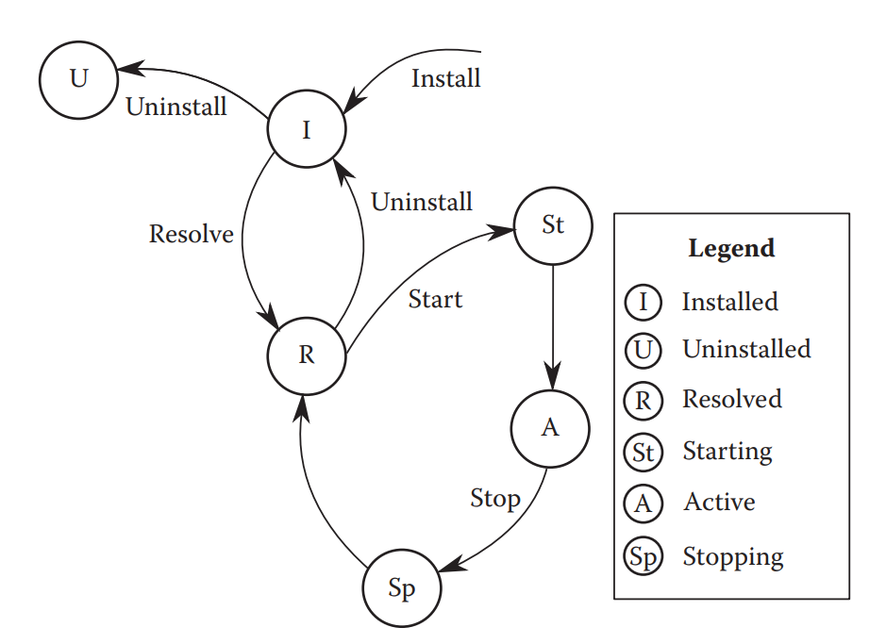
Life Cycle Layer
Notes:
- **Installed**
- A bundle can be installed by another bundle. Once it is, an object of type _Bundle_ is returned by the framework runtime. All life cycle operations such as astarting, stopping, or uninstalling of the bundle can be performed only through this object
- **Resolved**
- Once installed, the framework analyzes its manifest and determines the dependencies of the bundle.
- Resolves the import-package dependencies of the bundle by looking for other bundles that export the required packages. If the bundles dependencies are resolved, the state changes to _Resolved_.
- **Starting**
- A bundle in _Resolved_ state can be started by calling `start()` on the `Bundle` object.
- While the bundle transitions from _Resolved_ to _Active_, it is in the _Starting_ state.
- **Active**
- After a bundle has received a `start()` command, it gets activated after a transition state of _Starting_
- Just before activation, the framework checks if there is a `BundleActivator` defined in the manifest. If there is, the framework calls the `start()` method on the defined bundle activator.
- The `BundleActivator` provides a means for the bundle dev. to interfere with the bundle life cycle events.
- **Stopping**
- An active bundle can be stopped by calling the `stop()` method on the `Bundle` object. The bundle transitions through the _Stopping_ state to reach the _Resolved_ state.
- If a `BundleActivator` is defined in the manifest, the framework calls the `stop()` method on this.
- This intervention provides and opportunity for the bundle developer to clean up any resources being used by the bundle before it stops.
- **Uninstalled**
- A bundle can be uninstalled by calling the `uninstall()` method on the `Bundle` object.
- When a bundle is uninstalled, the framework notifies all the other bundles. If the bundle had exported any package and it is currently in use by other bundles, then the exported packages would continue to be available until the framework is stopped in spite of the uninstallation of the bundle.

Slide 6
OSGi Service
Service
Service Interface / Service Provider Interface
Service Object / Service Provider
Notes:
## 9. What are the elements of an OSGi service?
A service consists of a _service interface_ and a _service object_.
### Service Interface (Service Provider Interface)
- Akin to a provided interface of a component
- Defines a set of API operators
- Represents a conceptual contract between provider and consumer
### Service Object (Service Provider)
- Akin to an internal component implementation of the provided interface
- Provides implementation of the service
ServiceReference
The ServiceReference provides an indirection level that decouples direct dependency on the service object. The ServiceReference object carries the properties and other metadata information of the service that it represents. A bundle that wants to just examine the properties of the service provided by another bundle can do so with the help of a ServiceReference object. Once the bundle chooses to make use of the service, it can pass the ServiceReference to the BundleContext to get the service object. The ServiceReference object is valid only as long as the service object is registered

Slide 7
Portefølje Eksempel: OSGi Enemy
Declarative Services
BundleContext
<?xml version="1.0" encoding="UTF-8"?> <scr:component xmlns:scr="http://www.osgi.org/xmlns/scr/v1.1.0" name="dk.sdu.mmmi.cbse.osgienemy"> <implementation class="dk.sdu.mmmi.cbse.osgienemy.EnemyProcessor"/> <service> <provide interface="dk.sdu.mmmi.cbse.common.services.IEntityProcessingService"/> </service> <reference bind="setBulletService" cardinality="0..1" interface="dk.sdu.mmmi.cbse.common.bullet.BulletSPI" name="BulletService" policy="dynamic" unbind="removeBulletService"/> </scr:component>
Bundle bundle = FrameworkUtil.getBundle(BulletSPI.class); BundleContext context = bundle.getBundleContext(); ServiceReference bulletSR = context.getServiceReference(BulletSPI.class); private BulletSPI bulletService = (BulletSPI) context.getService(bulletSR);
Activator
Setter Injection
public class Activator implements BundleActivator { @Override public void start(BundleContext context) throws Exception { LaserSystem ls = new LaserSystem(); context.registerService(IEntityProcessingService.class, ls, null); context.registerService(BulletSPI.class, ls, null); }
public void setBulletService(BulletSPI bulletService) { this.bulletService = bulletService; } public void removeBulletService(BulletSPI bulletService) { this.bulletService = null; }
Notes:
OSGi Eksempler
Declarative Services, dependency injection
BundleContext, whiteboard modellen
Activator peges på i manifest filen for bundlen

Slide 8
Declarative Services
Manifest attributten
Service-Component peger på vores component.xml
Hvorfor?
Automatiser arbejdet!
Component description
Elementer:
Implementation
Service
Reference
<?xml version = "1.0" encoding = "UTF-8"?> <scr:component xmlns:scr = "http://www.osgi.org/xmlns/scr/v1.1.0" name = "org.project.package">
<implementation class = "org.project.package.MyService"/> <service>
<provide interface = "org.project.package.IMyService"/> </service>
</scr:component>
Notes:
Sits on top of the service layer.
Lets the bundle developers publish and consume services declaratively through the OSGi service layer. In short: it automates the registration and lookup of services, making dev-life easier.
### Declarative Services model
- A service provided by a bundle is described by a _service component_.
- the service component description is interpreted at runtime to create and destroy service objects as neccessasry
- is declared in a component description file (XML file inside the bundle)
- which is read and acted upon by the Service Component Runtime (SCR)
- a component declares the services that it provides and the dependencies it has to other components through _references_
#### Declaring a component:
Requires three things:
- An XML file that contains the component description
- A pointer to the component description file location using the bundle manifest (`MANIFEST.MF`) header `Service-Component: META-INF/component.xml`
- An implementation class as defined by the component description

